Slide 1
Mineral Resources

Slide 2
Minerals
Minerals are naturally occurring substances having definite chemical composition and physical properties.
Ores
Ores are the combinations of minarals.

Slide 3
Classification of Minerals
Identified
Undiscovered Resources
Reserves

Slide 4
Uses and exploitation
Development of industrial plants and machinery.
Iron, aluminium, copper.
Construction, Housing, Settlements
Iron, aluminium, nickel.
Generation of Energy
Coal, lignite, uranium.

Slide 5
Uses and exploitation
Jewellery
Gold, Silver, Platinum and diamond.
Communication purpose
Telephone wires, cables, electronic devices.
Medical purpose
Sulphur pyrites.

Slide 6
Types of Minerals
Based on Composition
Metallic (Iron, aluminium)
Non – Metallic( Quartz, Dolomite )
Based on Usage
Critical Minerals. ( Iron, aluminium )
Strategic Minerals.( Magnesium, Cobalt, Platinum )

Slide 7
Effects on Environment
Mining
Surface Mining.
Underground Mining.
Open pit mining
Dredging.
Strip Mining

Slide 8
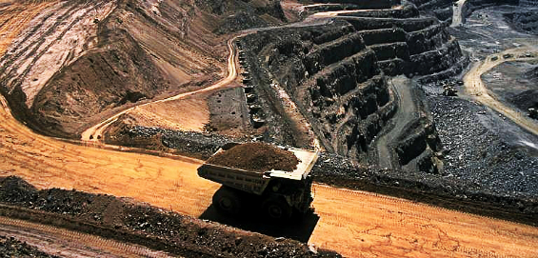
Open Pit Mining

Slide 9
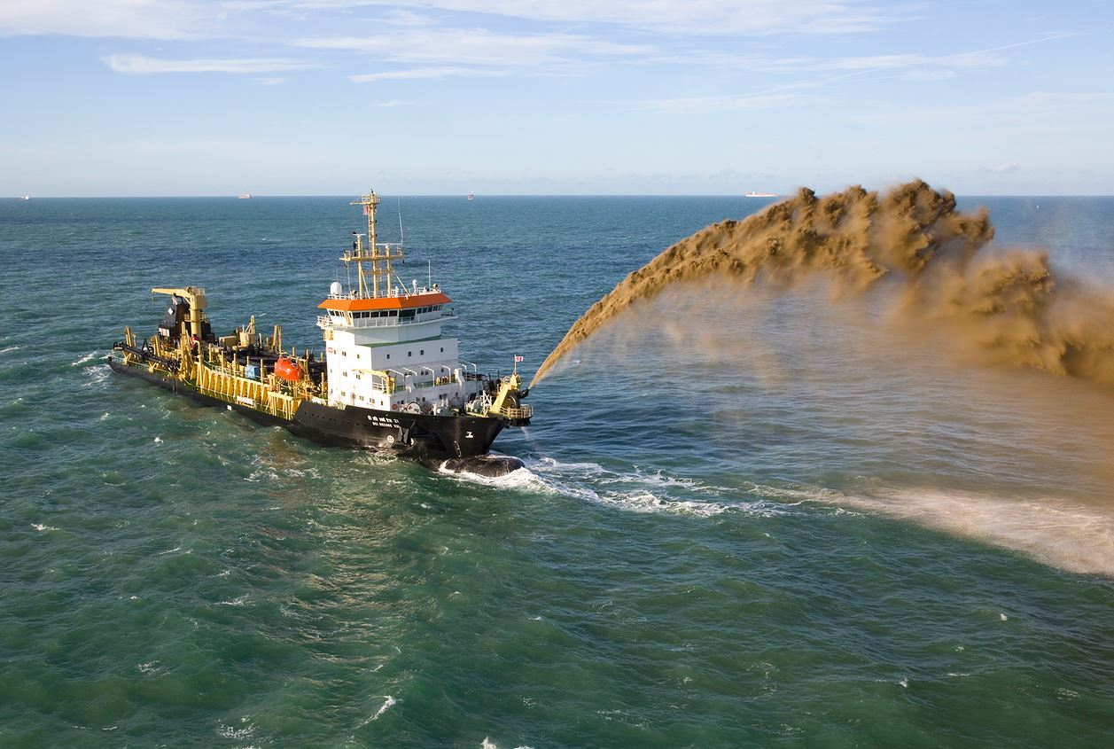
Dredging

Slide 10
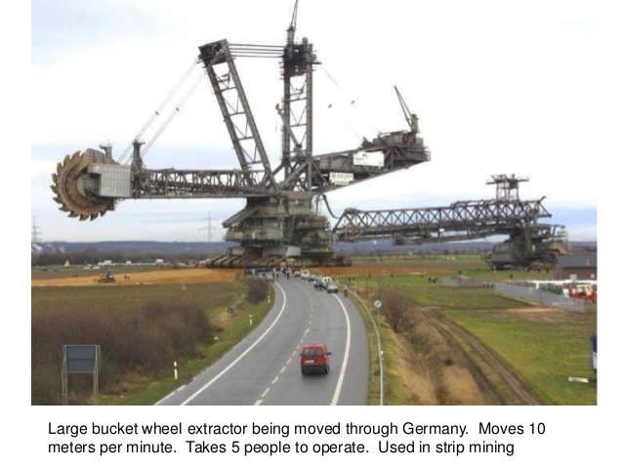
Strip Mining

Slide 11
Effects on Environment
Devegetation and defacing of landscape.
Ground Water Contamination.
Surface water pollution.
Air Pollution.
Subsidence of land.

